Slide 1
Sales & Profit Analysis Dashboard
Task 4 - Data Storytelling & Statistical Validation

Slide 2
Introduction
This project is part of Task 4 of my Data Analytics Internship at ApexPlanet. It focuses on data storytelling using a Sales and Profit Analysis dashboard created in Power BI. The goal is to analyze key metrics, identify trends, and derive insights to support better business decision-making. This dashboard enables data-driven decision-making for business growth.

Slide 3
Overall Performance
Total Sales: 2.30M
Total Profit: 286.40K
Total Discount: 1.56K
Insight: The business generates strong sales, but profit is comparatively lower, indicating possible low margins or high discount impact.

Slide 4
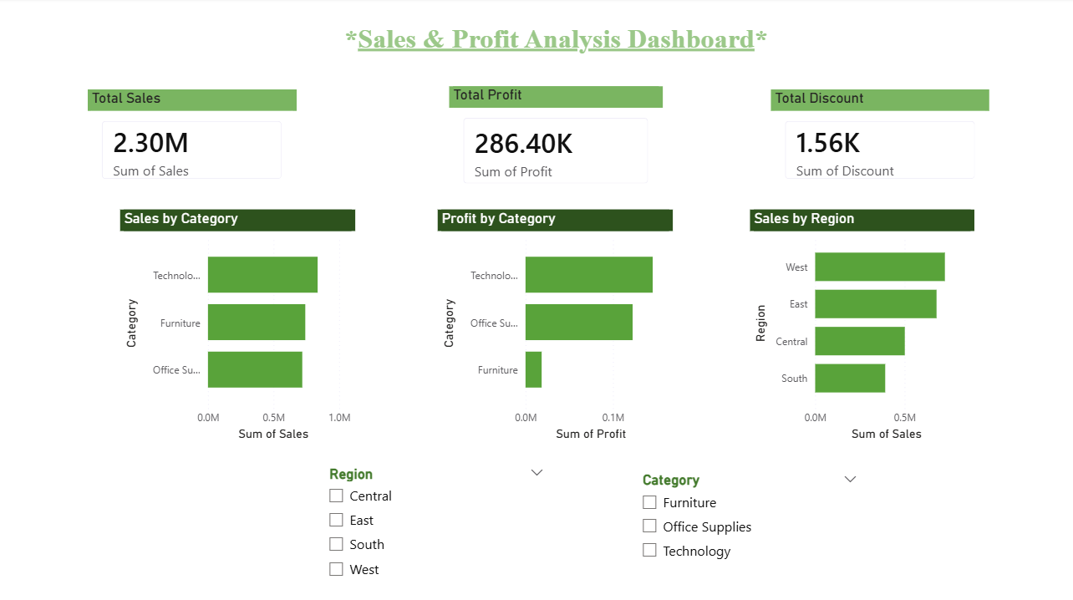
KPI Cards

Slide 5
Category Analysis
Technology has the highest sales and profit.
Office Supplies shows stable performance
Furniture has moderate sales but very low profit
Key Insight:
High sales does not always result in high profit, as seen in the Furniture category.

Slide 6
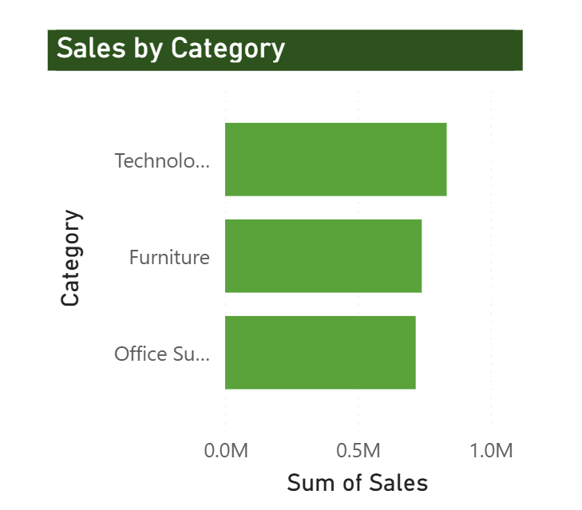

Slide 7
Regional Analysis
The West region has the highest sales.
East follows with a strong performance.
Central is moderate.
South has the lowest sales.
Key Insight:
Sales performance varies by region, with the South needing improvement.

Slide 9
Analytical Insights
The analysis highlights variations in sales and profit across different categories and regions. It shows that higher sales do not always translate into higher profit, indicating differences in cost structure and discount impact. The data also reflects an uneven distribution of profitability, suggesting that certain segments perform better than others.
Key Points:
Profit distribution varies across categories
High sales does not always mean high profit
Furniture category shows low profitability
Sales are concentrated more in the West region

Slide 10
Hypothesis Testing
Hypothesis:
H0 (Null): Discount has no significant effect on Profit.
H1 (Alternative): Discount significantly affects Profit.
Method:
Correlation analysis / basic statistical test
Result:
A negative relationship is observed between discount and profit.
Interpretation:
Higher discounts lead to lower profitability.
Business Conclusion:
Discount strategies should be optimized to improve profit margins.

Slide 11
Key Insights
Technology is the top-performing category
Furniture is low in profitability
West region dominates sales
South region underperforms
Profit margins are inconsistent

Slide 12
Conclusion
The analysis shows that while overall sales performance is strong, profitability varies across categories and regions. Technology emerges as the top-performing category, whereas Furniture requires improvement due to low profit margins. Regionally, the West leads in sales, while the South lags. The findings highlight the need to focus on improving profit margins and strengthening underperforming segments.
Improve profit margins in Furniture
Focus growth strategies in the South region

Slide 13
Project By, DEVYANI VISHWAS KHANDAT
THANK YOU

